Slide 1
Stroke Prediction Using Machine Learning
Logistic Regression Model for Stroke Prediction
Sumit Singh

Slide 2
Project Objective
Predict the likelihood of a stroke using patient data.
Focus on medical features like age, glucose level, BMI, and hypertension.
Goal: Provide actionable insights for healthcare.

Slide 3
Dataset Overview
Contains features like age, glucose level, hypertension, heart disease, etc.
Target variable: Stroke (Yes/No).
Class imbalance: Stroke cases are only 5% of the data.

Slide 4
Data Cleaning Process
Handled missing values using imputation.
Converted categorical features using one-hot encoding.
Scaled numerical features using MinMaxScaler.

Slide 5
Exploratory Data Analysis (EDA)
Visualized distribution of features like age, glucose, and BMI.
Identified key trends: Older patients more likely to have strokes.

Slide 6
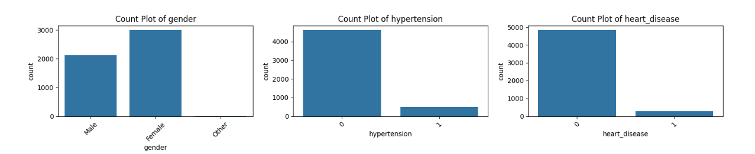
Data Visualization
Counts of Each Categorical Variable

Slide 7
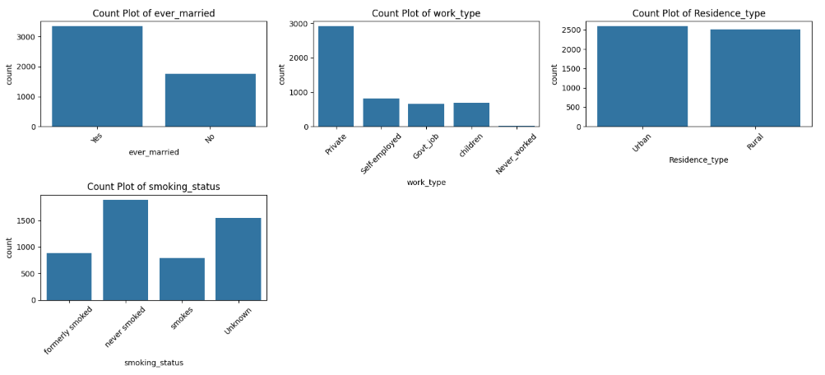
Data Visualization
Counts of Each Categorical Variable

Slide 8
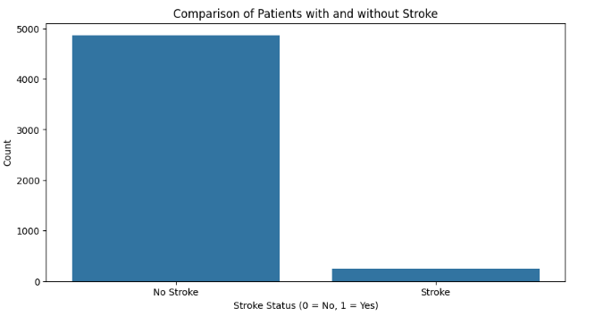
Data Visualization
Comparison of Patients with and without Stroke

Slide 9
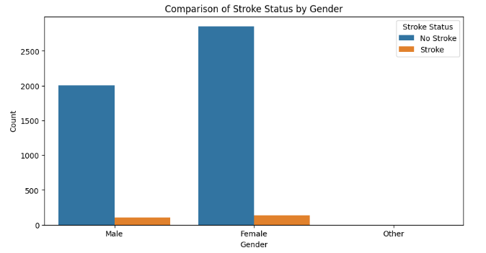
Data Visualization
Stroke Patients by Gender

Slide 10
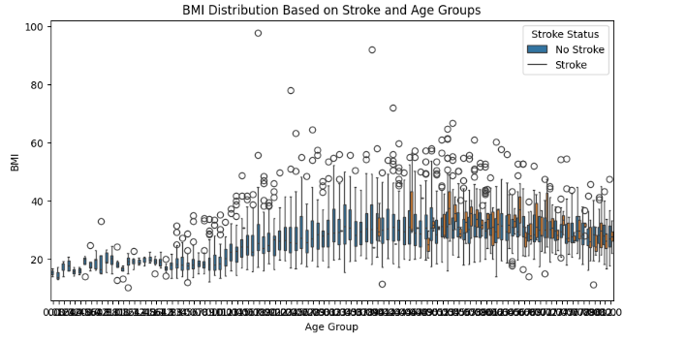
Data Visualization
Duration Based on Age Groups

Slide 11
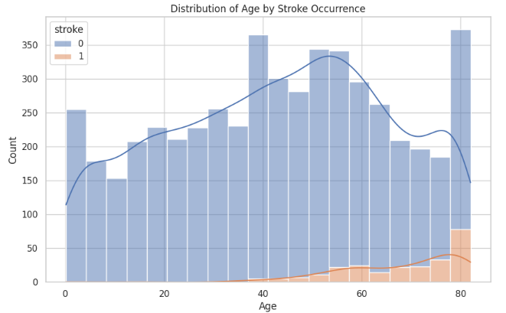
Data Visualization - Pairplot
Plot 1: Distribution of Age, with hue for stroke occurrences
Age Distribution by Stroke Occurrence
Observation: The age distribution plot indicates that stroke occurrences increase with age, especially for individuals aged 50 and above. Younger individuals show a lower frequency of stroke, suggesting age as a potential risk factor.

Slide 12
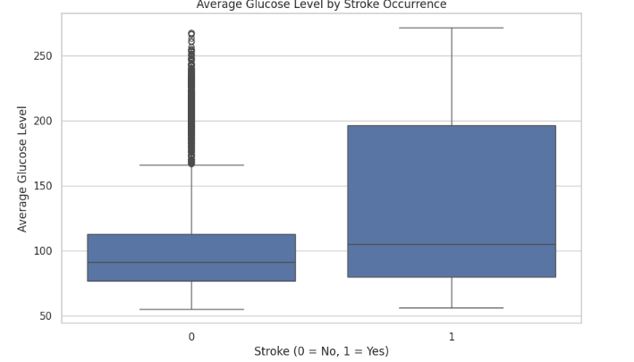
Data Visualization - Pairplot
Plot 2: Boxplot of Average Glucose Level by Stroke
Average Glucose Level by Stroke Occurrence
Observation: The boxplot of average glucose levels reveals that individuals who had a stroke generally show higher glucose levels compared to those who did not. This could indicate that elevated glucose levels are associated with an increased risk of stroke.

Slide 13
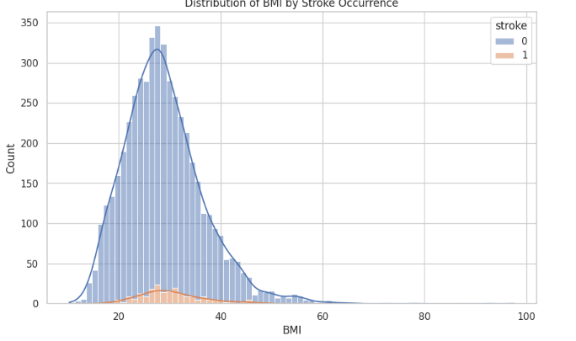
Data Visualization - Pairplot
Plot 3: Distribution of BMI by Stroke Occurrence
BMI Distribution by Stroke Occurrence
Observation: The BMI distribution does not show a drastic difference between stroke and non-stroke groups, but individuals with higher BMI may have a slightly higher tendency toward stroke. Further analysis could determine if BMI is a significant factor.

Slide 14
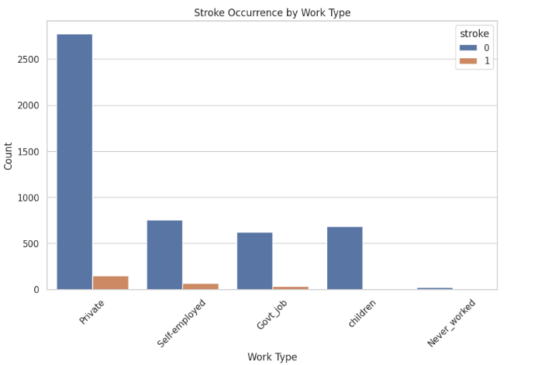
Data Visualization - Pairplot
Plot 4: Bar Plot of Stroke Occurrence by Work Type
Stroke Occurrence by Work Type
Observation: The plot of stroke occurrence across different work types suggests that individuals in certain job categories, like "Self-employed" and "Private," have higher instances of stroke. Those categorized as "Never_worked" have significantly lower instances, potentially due to younger age or other factors.

Slide 15
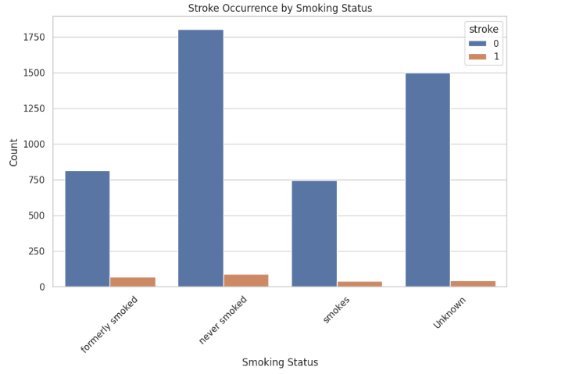
Data Visualization - Pairplot
Plot 5: Bar Plot of Stroke Occurrence by Smoking Status
Stroke Occurrence by Smoking Status
Observation: The count plot shows that individuals who are current or former smokers have a higher incidence of stroke compared to those who never smoked. This suggests that smoking history could contribute to stroke risk.

Slide 16
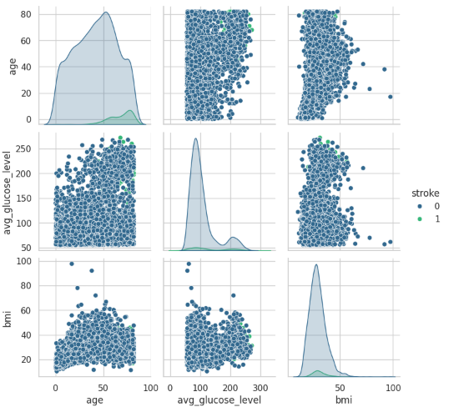
Data Visualization - Pairplot
Pairplot: Relations among Age, Avg Glucose Level, and BMI for stroke variable

Slide 17
Data Visualization Insights
Age Distribution
Glucose Levels
Work Type
The age distribution plot indicates that stroke occurrences increase with age, especially for individuals aged 50 and above.
The boxplot of average glucose levels reveals that individuals who had a stroke generally show higher glucose levels compared to those who did not.
The plot of stroke occurrence across different work types suggests that individuals in certain job categories, like "Self-employed" and "Private," have higher instances of stroke.

Slide 18
Machine Learning Workflow
1. Data Preprocessing
2. Train-Test Split
3. Model Building (Logistic Regression)
4. Evaluation and Optimization

Slide 19
Logistic Regression Model Overview
Predicts the probability of a binary outcome (stroke or not).
Uses the sigmoid function for predictions: s(x) = 1 / (1 + e^(-x))

Slide 20
Model Evaluation Metrics
Evaluated using:
Accuracy, Precision, Recall, F1 Score.
Confusion Matrix for true/false positives and negatives.

Slide 21
Model Performance
Confusion Matrix:
True Positives (TP): 1
False Positives (FP): 0
False Negatives (FN): 61
True Negatives (TN): 960
Precision: 1.0, Recall: 0.016, F1 Score: 0.032

Slide 22
Precision-Recall Tradeoff
The Precision-Recall curve highlights the tradeoff between precision and recall.
High precision but low recall, suggesting the model misses many true positive cases.

Slide 23
RMSE Comparison
Linear Regression RMSE: 0.23
Ridge Regression RMSE: 0.23
Lasso Regression RMSE: 0.24
Logistic Regression RMSE: 0.24

Slide 24
Handling Class Imbalance
Addressed class imbalance using:
Oversampling (SMOTE)
Penalizing misclassifications in models.

Slide 25
Feature Importance
Key features influencing stroke prediction:
Age, Glucose Level, BMI.
Logistic regression coefficients show feature weights.

Slide 26
Model Improvements
Recommendations:
Try more advanced models (Random Forest, XGBoost).
Improve class balancing techniques.
Conduct hyperparameter tuning.

Slide 27
Conclusion & Next Steps
The Logistic Regression model provides useful insights but requires further improvement.
Future work: Explore more complex models, fine-tune parameters, and handle class imbalance.

